Slide 1
Multiple Regression Analysis
y = β₀ + β₁x₁ + β₂x₂ + . . . β_{k}x_{k} + u
Further Issues

Slide 2
Redefining Variables
Suppose we have a linear model
y = β₀ + β₁x₁ + β₂x₂ + . . . β_{k}x_{k} + u
What happens if y changes to 2y?
2y = 2β₀ + 2β₁x₁ + 2β₂x₂ + . . . 2β_{k}x_{k} + 2u
What happens if x₁ changes to 10 x₁?
We hope the measured effects and testing outcome doesn’t change (t, F, R² et al.)

Slide 3
Redefining Variables
Changing the scale of the y variable will lead to a corresponding change in the scale of the coefficients and standard errors, so no change in the significance or interpretation.
Changing the scale of one x variable will lead to a change in the scale of that coefficient and standard error, so no change in the significance or interpretation.

Slide 4
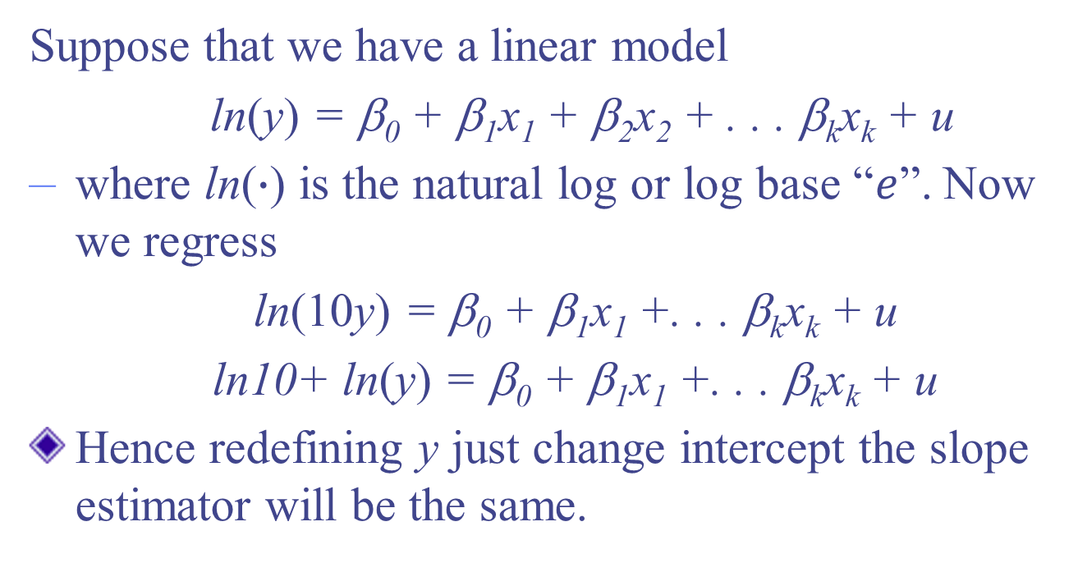
Exp. Redefining Variables
Suppose that we have a linear model
ln(y) = β₀ + β₁x₁ + β₂x₂ + . . . β_{k}x_{k} + u
where ln($∙$) is the natural log or log base “$e$”. Now we regress
ln(10y) = β₀ + β₁x₁ +. . . β_{k}x_{k} + u
ln10+ ln(y) = β₀ + β₁x₁ +. . . β_{k}x_{k} + u
Hence redefining y just change intercept the slope estimator will be the same.

Slide 5
Exp. Redefining Variables
Suppose that we have a linear model
y = β₀ + β₁x₁ + β₂x₂ + . . . β_{k}x_{k} + u
now we regress
y = β₀ + β₁(x₁/c)+ β₂x₂ +. . . β_{k}x_{k} + u
Here, dividing x₁ by a constant c. For example, we change x₁ from dollars to thousands of dollars, then c=1000.

Slide 6
Exp. Redefining Variables
Suppose that we have a linear model
y = β₀ + β₁x₁ + β₂x₂ + . . . β_{k}x_{k} + u
now we regress
y = β₀ + β₁(x₁/c)+ β₂x₂ +. . . β_{k}x_{k} + u
y = β₀ + (cβ₁)β₁(x₁/c)+ β₂x₂ +. . . β_{k}x_{k} + u
The regression requires the coefficient of x₁ must be multiplied by c.

Slide 7
Functional Form
OLS can be used for relationships that are not strictly linear in x and y by using nonlinear functions of x and y – will still be linear in the parameters
Can take the natural log of x, y or both
Can use polynomial forms of x
Can use interactions of x variables

Slide 8
Functional Form
OLS can be used for relationships that are not strictly linear in x and y by using nonlinear functions of x and y – will still be linear in the parameters
Can take the natural log of x, y or both
Can use polynomial forms of x
Can use interactions of x variables

Slide 9
Why use log models?
They give a direct estimate of elasticity, which is widely used in economic theory.
Data may be highly skewed, or influenced by the presence of outliers, taking the log i.e., ln(y) will be more narrow, limiting the effect of outliers.
Why we do not want outliers?

Slide 10
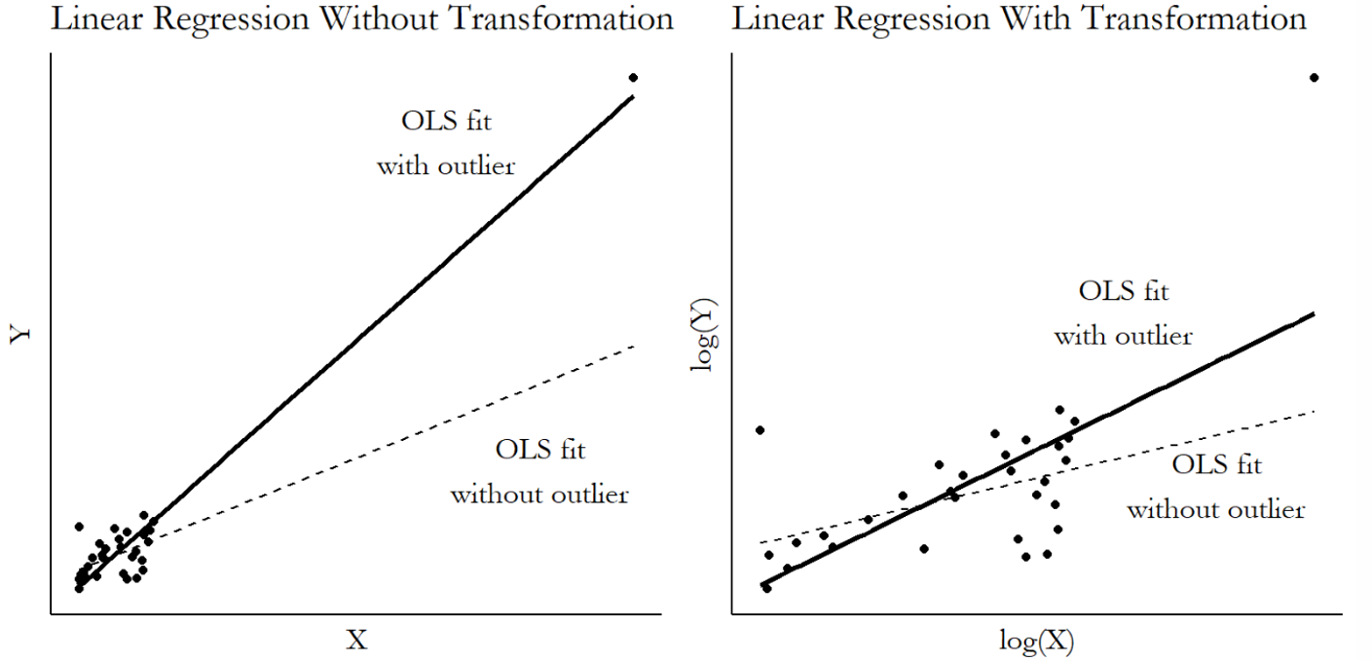
Why use log models?
Why we do not want outliers?

Slide 11
Interpretation of Log Models
If the model is ln(y) = β₀ + β₁ln(x) + u
  β₁ is the elasticity of y with respect to x
If the model is ln(y) = β₀ + β₁x + u
  100∗β₁ is approximately the percentage change in y given a 1 unit change in x
If the model is y = β₀ + β₁ln(x) + u
  0.01∗β₁ is approximately the change in y for a 1 percent change in x

Slide 12
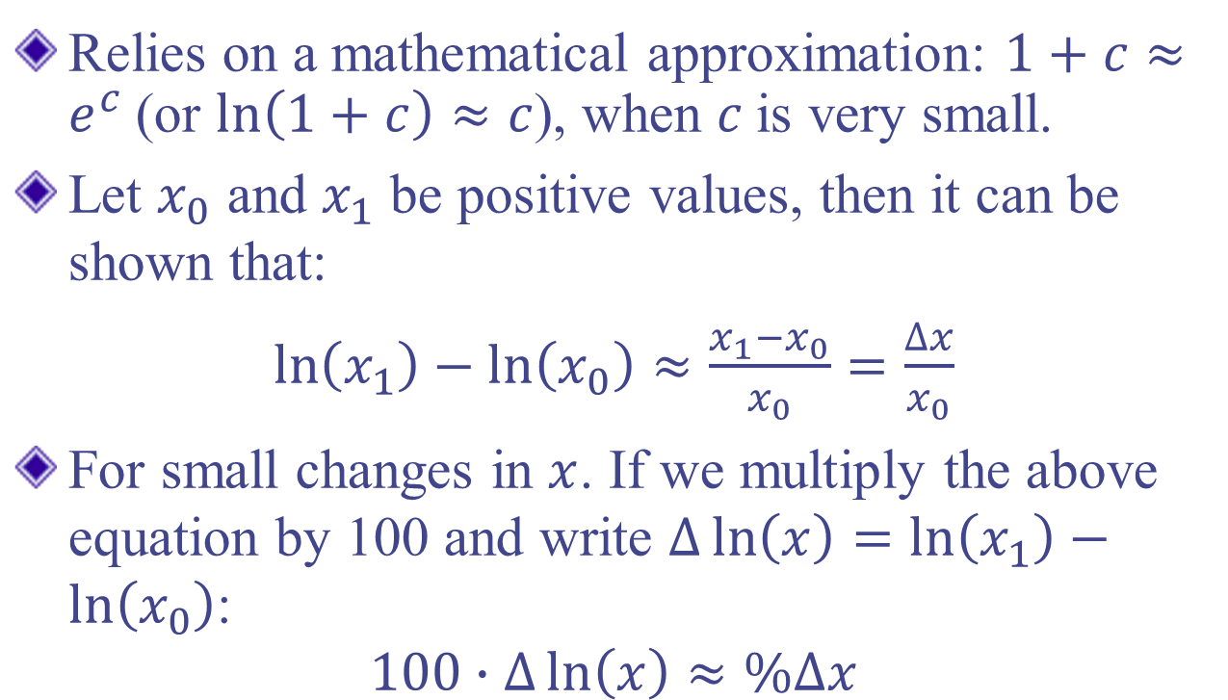
Interpretation of Log Models
Relies on a mathematical approximation: $1+c≈e^{c}$(or $\ln\left(1+c\right)≈c$), when $c$is very small.
Let $x_{0}$ and $x_{1}$ be positive values, then it can be shown that:
$\ln\left(x_{1}\right)−\ln\left(x_{0}\right)≈\frac{x_{1}−x_{0}}{x_{0}}=\frac{∆x}{x_{0}}$
For small changes in $x$. If we multiply the above equation by 100 and write $∆\ln\left(x\right)=\ln\left(x_{1}\right)−\ln\left(x_{0}\right)$:
$$100∙∆\ln\left(x\right)≈\%∆x$$

Slide 13
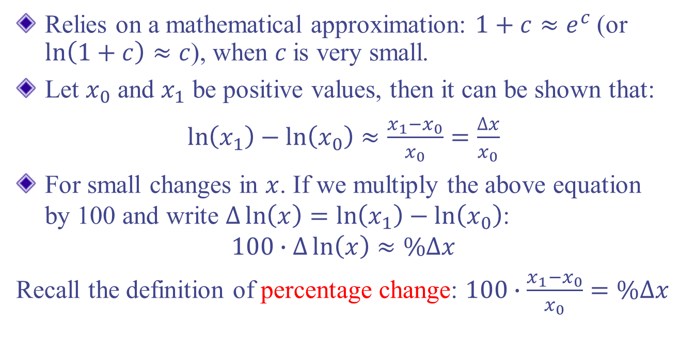
Interpretation of Log Models
Relies on a mathematical approximation: $1+c≈e^{c}$(or $\ln\left(1+c\right)≈c$), when $c$is very small.
Let $x_{0}$ and $x_{1}$ be positive values, then it can be shown that:
$\ln\left(x_{1}\right)−\ln\left(x_{0}\right)≈\frac{x_{1}−x_{0}}{x_{0}}=\frac{∆x}{x_{0}}$
For small changes in $x$. If we multiply the above equation by 100 and write $∆\ln\left(x\right)=\ln\left(x_{1}\right)−\ln\left(x_{0}\right)$:
$$100∙∆\ln\left(x\right)≈\%∆x$$
Recall the definition of percentage change: $100∙\frac{x_{1}−x_{0}}{x_{0}}=\%∆x$

Slide 14
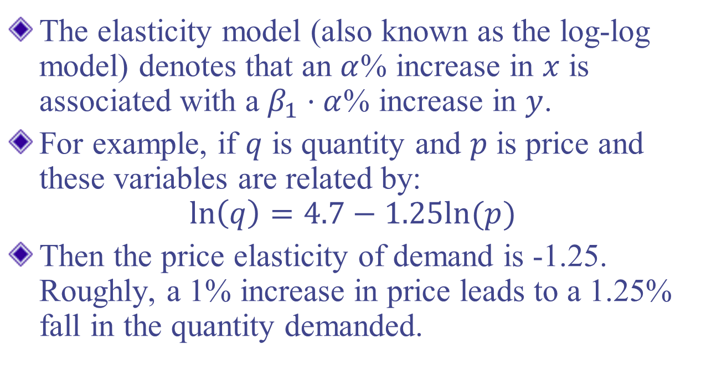
Exp. Log-log Models
The elasticity model (also known as the log-log model) denotes that an $α$% increase in $x$ is associated with a $β_{1}⋅α$% increase in $y$.
For example, if $q$ is quantity and $p$ is price and these variables are related by:
$$\ln\left(q\right)=4.7−1.25ln⁡(p)$$
Then the price elasticity of demand is -1.25. Roughly, a 1% increase in price leads to a 1.25% fall in the quantity demanded.

Slide 15
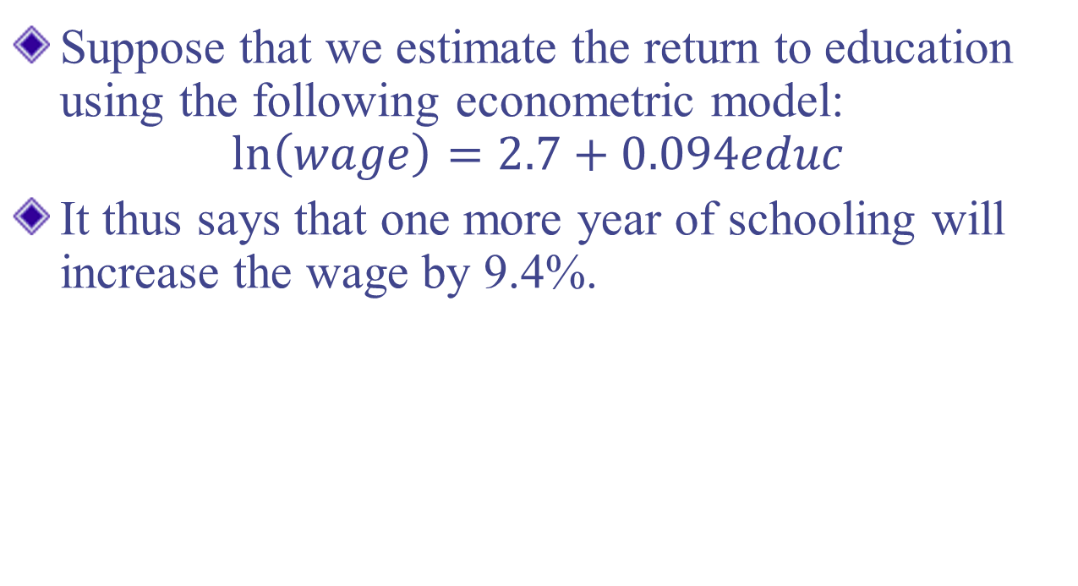
Exp. Semi-elasticity Models
Suppose that we estimate the return to education using the following econometric model:
$$\ln\left(wage\right)=2.7+0.094educ$$
It thus says that one more year of schooling will increase the wage by 9.4%.

Slide 16
Some Rules of Thumb for log
What types of variables are often used in log form?
Dollar amounts that must be positive
Very large variables, such as population
What types of variables are often used in level form?
Variables measured in years
Variables that are discrete
Variables that are a proportion or percent

Slide 17
Some Rules of Thumb for log
Since ln(0) is undefined, what if we have zero-valued data?
If a few y=0, common workaround, take ln(1+y).
In this case, lose some useful properties of the log.

Slide 18
Functional Form
OLS can be used for relationships that are not strictly linear in x and y by using nonlinear functions of x and y – will still be linear in the parameters
Can take the natural log of x, y or both
Can use polynomial forms of x
Can use interactions of x variables

Slide 19
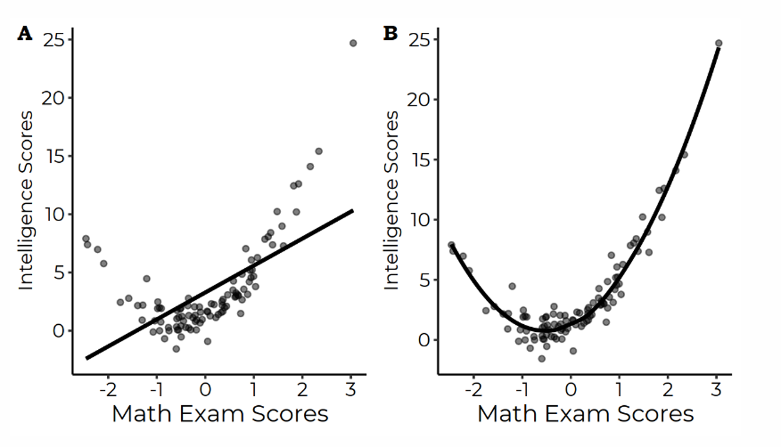
Regression with Polynomial Terms
Sometimes, a linear model isn’t enough (even after log transformations).

Slide 20
Regression with Polynomial Terms
By adding polynomial terms (e.g., cubic or quadratic), may yield a better fit.

Slide 21

Quadratic Models
Can capture increasing/decreasing maginal effect
For a model of the form y = β₀ + β₁x + β₂x² + u, we can’t interpret β₁ alone as measuring the change in y with respect to x, we need to take into account β₂ as well, since

Slide 22
Quadratic Models
Suppose that the coefficient on x is positive (β₁>0) and the coefficient on x² (β₂<0) is negative
Then y is increasing in x at first, but will eventually turn around and be decreasing in x
Then, how to calculate the turning point?

Slide 23
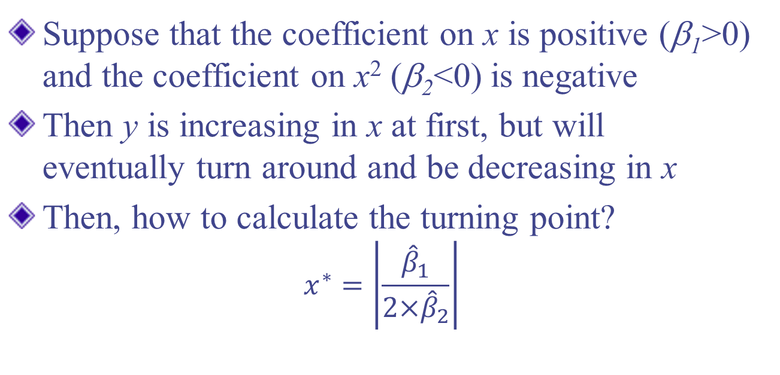
Quadratic Models
Suppose that the coefficient on x is positive (β₁>0) and the coefficient on x² (β₂<0) is negative
Then y is increasing in x at first, but will eventually turn around and be decreasing in x
Then, how to calculate the turning point?
$$x^{∗}=\left|\frac{{\hat{β}}_{1}}{{2×\hat{β}}_{2}}\right|$$

Slide 24
Exp. Quadratic Models
Suppose we estimate the wage function as follow:
Wage = 3.73 + .298exper - .0061exper² + u
experience has a diminishing marginal effect of on wage
first year effect: 0.298-2×(.0061)(1)
second year effect: 0.298-2×(.0061)(2)
turn around point: 0.298/[2×(.0061)] = 24.4

Slide 25
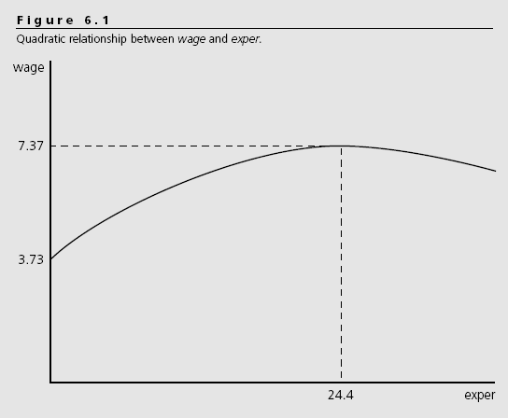

Slide 26
Functional Form
OLS can be used for relationships that are not strictly linear in x and y by using nonlinear functions of x and y – will still be linear in the parameters
Can take the natural log of x, y or both
Can use polynomial forms of x
Can use interactions of x variables

Slide 27

Interaction Terms
For a model of the form y = β₀ + β₁x₁ + β₂x₂ + β₃x₁x₂ + u, we can’t interpret β₁ alone as measuring the change in y with respect to x₁, we need to take into account β₃ as well, since

Slide 28
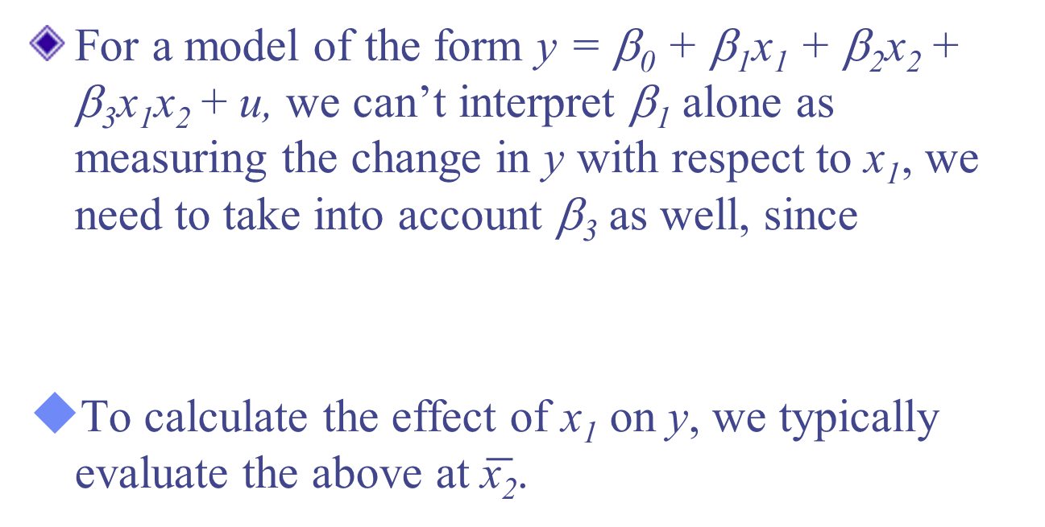
Interaction Terms
For a model of the form y = β₀ + β₁x₁ + β₂x₂ + β₃x₁x₂ + u, we can’t interpret β₁ alone as measuring the change in y with respect to x₁, we need to take into account β₃ as well, since
To calculate the effect of x₁ on y, we typically evaluate the above at $\overline{\text{x}\text{2}}$.

Slide 29
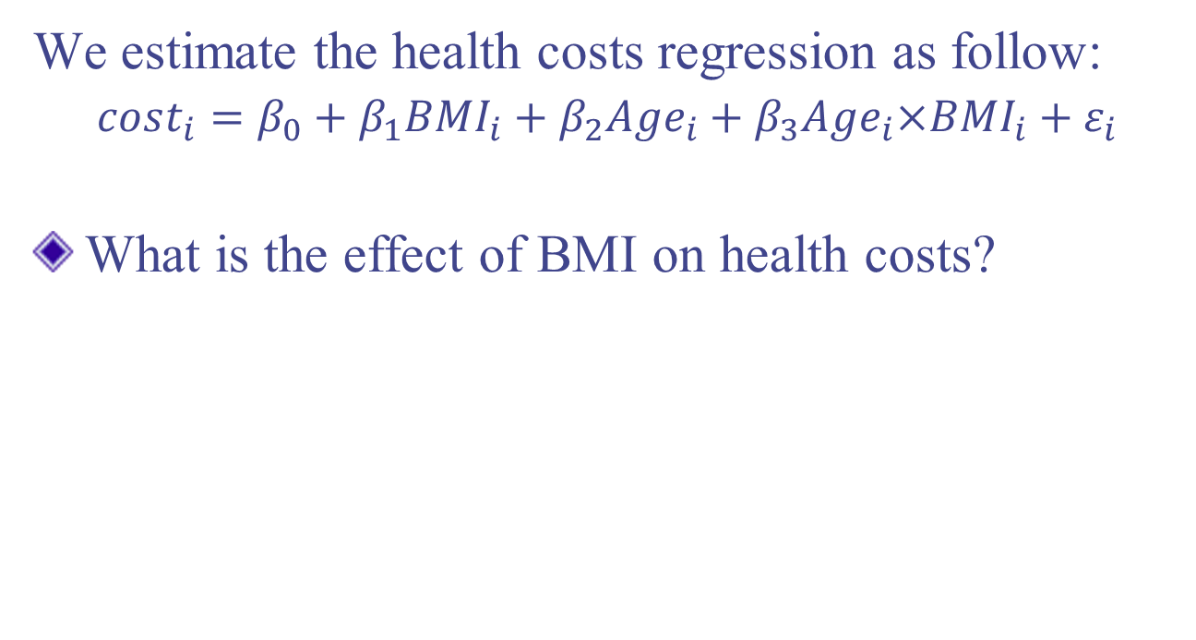
Exp. Interaction Terms
We estimate the health costs regression as follow:
$cost_{i}=β_{0}+β_{1}BMI_{i}+β_{2}Age_{i}+β_{3}Age_{i}×BMI_{i}+ε_{i}$
What is the effect of BMI on health costs?

Slide 30
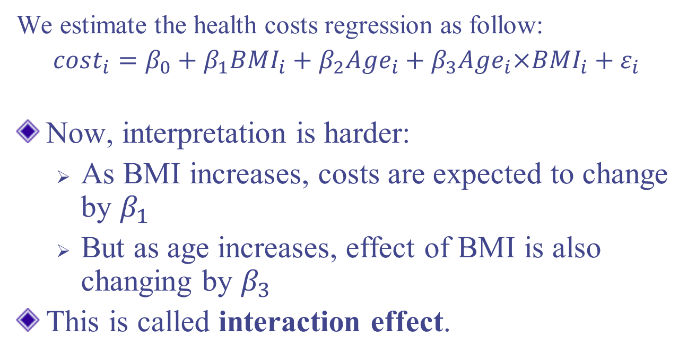
Exp. Interaction Terms
We estimate the health costs regression as follow:
$cost_{i}=β_{0}+β_{1}BMI_{i}+β_{2}Age_{i}+β_{3}Age_{i}×BMI_{i}+ε_{i}$
Now, interpretation is harder:
  As BMI increases, costs are expected to change by $β_{1}$
  But as age increases, effect of BMI is also changing by $β_{3}$
This is called interaction effect.

Slide 31
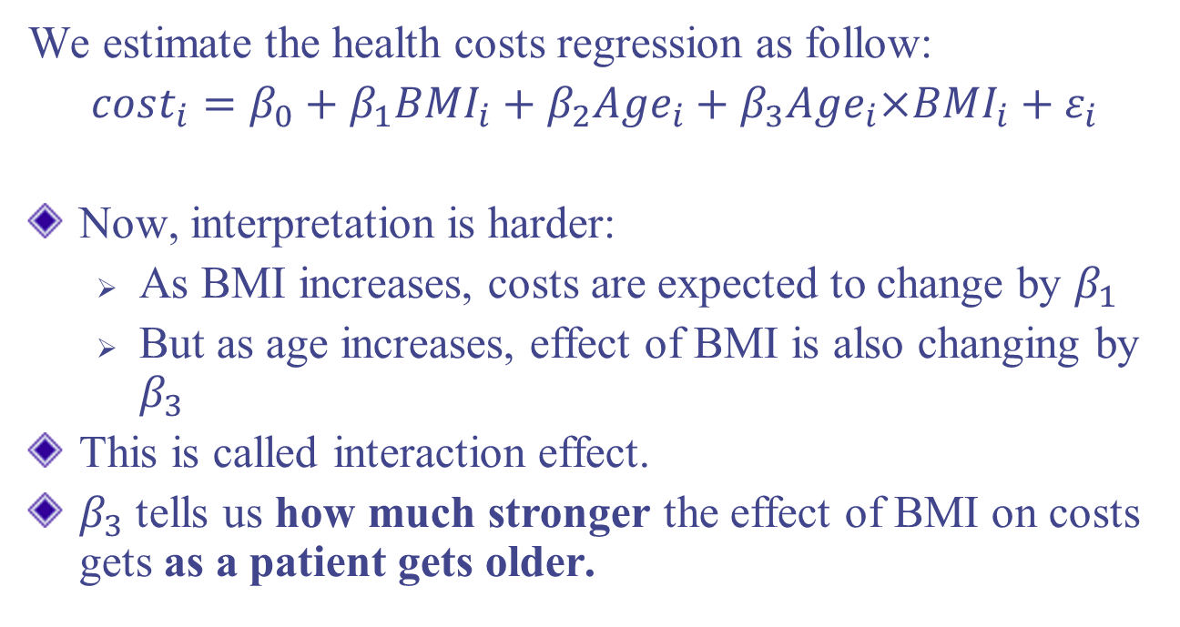
Exp. Interaction Terms
We estimate the health costs regression as follow:
$cost_{i}=β_{0}+β_{1}BMI_{i}+β_{2}Age_{i}+β_{3}Age_{i}×BMI_{i}+ε_{i}$
Now, interpretation is harder:
  As BMI increases, costs are expected to change by $β_{1}$
  But as age increases, effect of BMI is also changing by $β_{3}$
This is called interaction effect.
$β_{3}$ tells us how much stronger the effect of BMI on costs gets as a patient gets older.

Slide 32
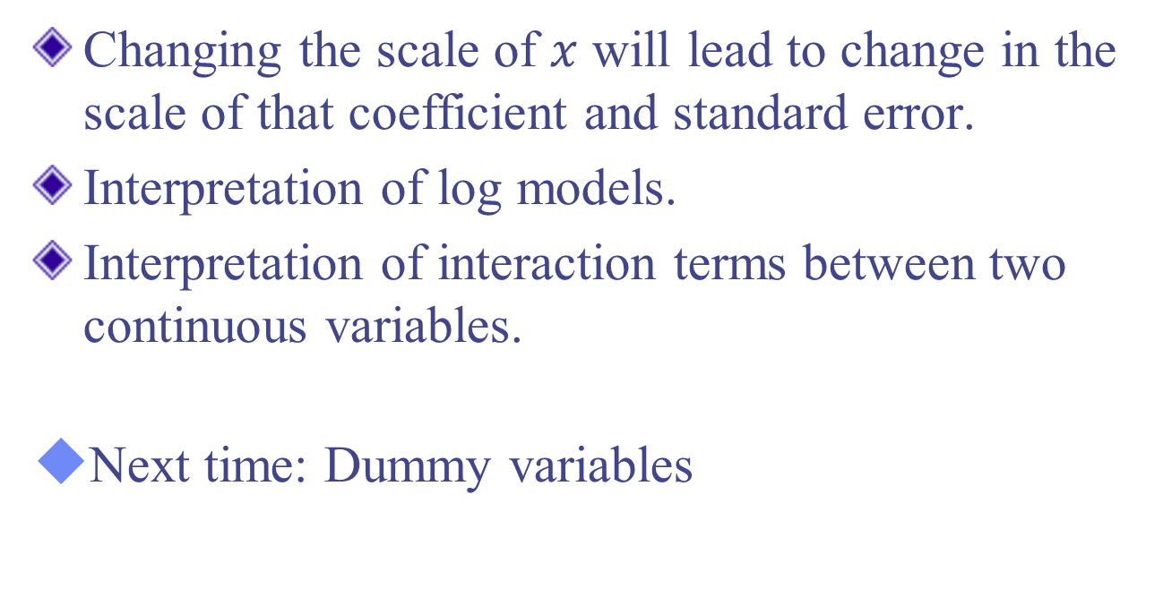
Conclusion
Changing the scale of $x$ will lead to change in the scale of that coefficient and standard error.
Interpretation of log models.
Interpretation of interaction terms between two continuous variables.
Next time: Dummy variables

